Slide 1
Name email@university.se
Portrait picture
<Department>, <University>
Industrial PhD Student at <Company> if applicable
<Supervisor(s)>
<Degree, University (year)>
Research topics
<Topic1>
<Topic2>
<Topic3>
<Preliminary title of thesis/project>
<Short description of research / research topics>
University /Company logo
Department/Group logo

Slide 2
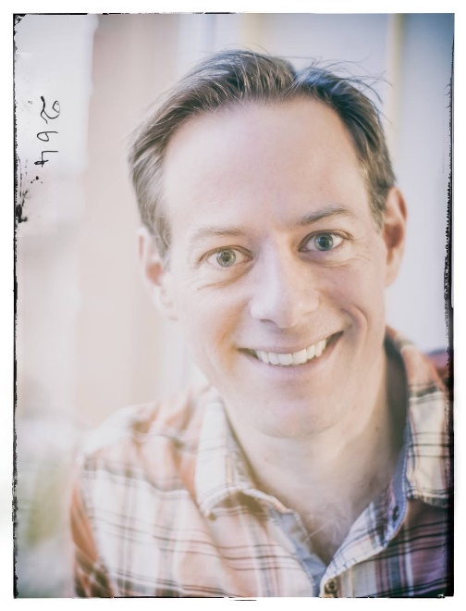
Fredrik Heintz fredrik.heintz@liu.se
AI and Machine learning
Department of Computer Science, Linköping
PhD in Computer Science, Linköping University (2009)
Associate Professor in Computer Science, Linköping University (2014)
Research topics:
AI
Stream reasoning
Computer science education
DyKnow: A Stream-Based Knowledge Processing Middleware Framework
Developing methods for incremental reasoning over streaming information (stream reasoning) and grounding it in the world through sensing.
Applied to collaborative unmanned aircraft systems.

