Slide 1
My Experiences in WARA (WASP Research Arenas)
Olov Andersson – Batch1 AS Student
Artificial Intelligence and Integrated Computer Systems
Department of Computer and Information Science
Linköping University
Notes:
I'm Olov Andersson, and I'm going to present some joint work with my colleagues at Linköping University here in Sweden.
The title of the paper is Model-Predictive Control with Stochastic Collision Avoidance using Bayesian Policy Optimization

Slide 2
Context of This Talk
For those of you that don’t know, WARA are arenas in WASP where you can demonstrate your research on real autonomous systems
Prof. Bo Wahlberg & Jesper Tordenlid will give a general talk about WARA tomorrow at 11:15
I was asked to talk briefly about my experiences in WARA
Bio:
WASP AS Batch1 student, close to defending my thesis
Demoed with a real robot (quadcopter) last year
This is all my personal views

Slide 3
What Can WARA Do For Us?
Test your theory in the real-world and collect data for papers
You can learn a lot talking to the partners
Identify new research problems/data
Learn practical skills attractive to applied R&D
Good showcase for your research career
Advice: Demonstrating is hard work but fun – push your limits
Can participate just to collect e.g. sensor data
Partner with somebody with application experience
Mind the theory-application gap, but it is also an opportunity

Slide 4
What Can WARA Do For Us?
Test your theory in the real-world and collect data for papers
You can learn a lot talking to the partners
Identify new research problems/data
Learn practical skills attractive to applied R&D
Good showcase for your research career
Advice: Demonstrating is hard work but fun – push your limits
Can participate just to collect e.g. sensor data
Partner with somebody with application experience
Mind the theory-application gap, but it is also an opportunity

Slide 5
What Can WARA Do For Us?
Test your theory in the real-world and collect data for papers
You can learn a lot talking to the partners
Identify new research problems/data
Learn practical skills attractive to applied R&D
Good showcase for your research career
Advice: Demonstrating is hard work but fun – push your limits
Can participate just to collect e.g. sensor data
Partner with somebody with application experience
Mind the theory-application gap, but it is also an opportunity

Slide 6
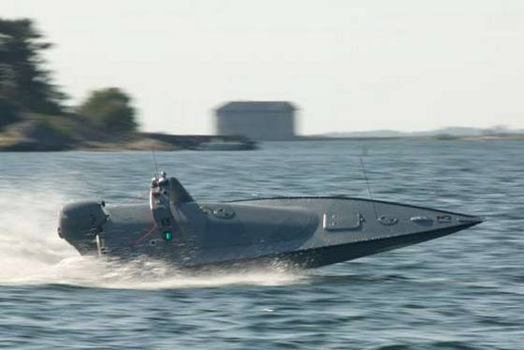
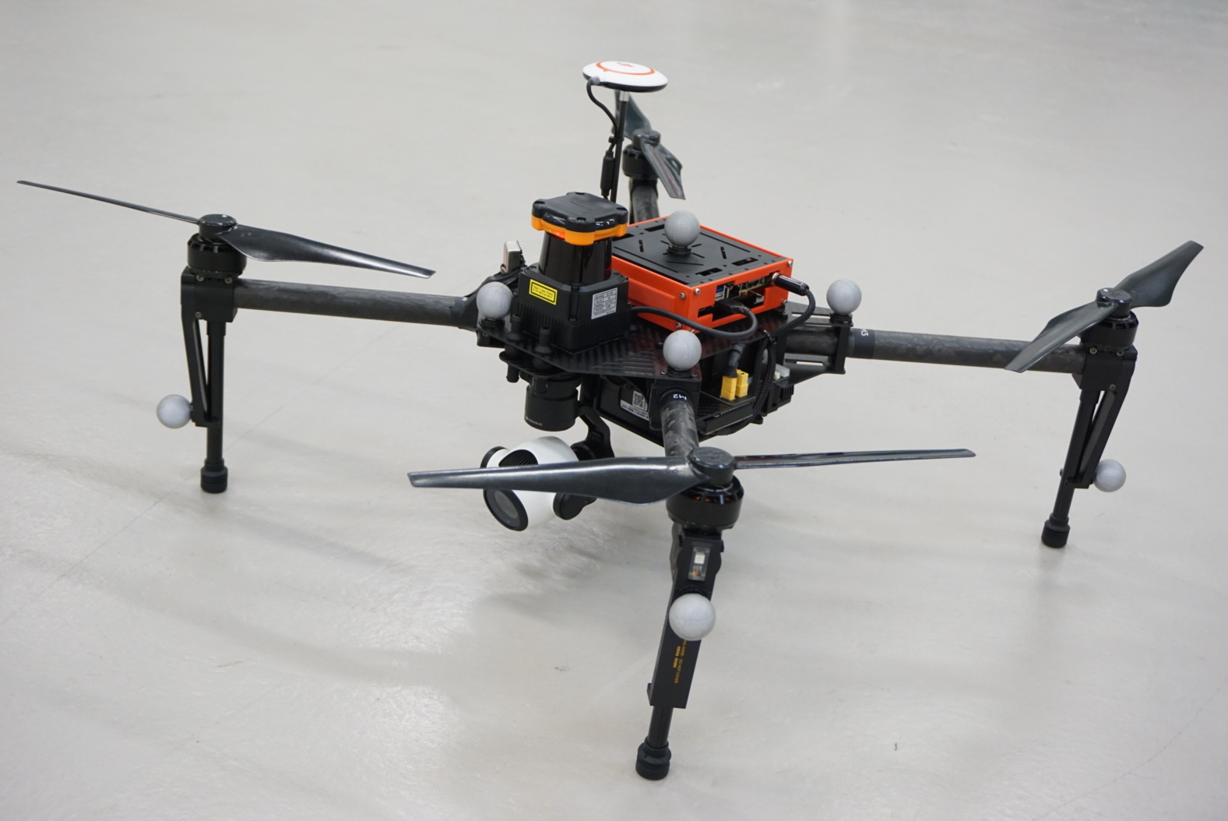
WARA-PS: Real-world Autonomous Systems
Several participants with experience in real-world applications (SAAB Kockums, Ericsson, Axis...)
Several different real-world autonomous systems (seafaring, flying and more...) and sensors (camera, stereo, LIDAR...)
Software architectures, in the cloud and on-board, e.g. ROS – Robot Operating System

Slide 7
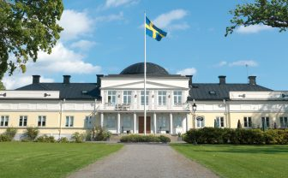
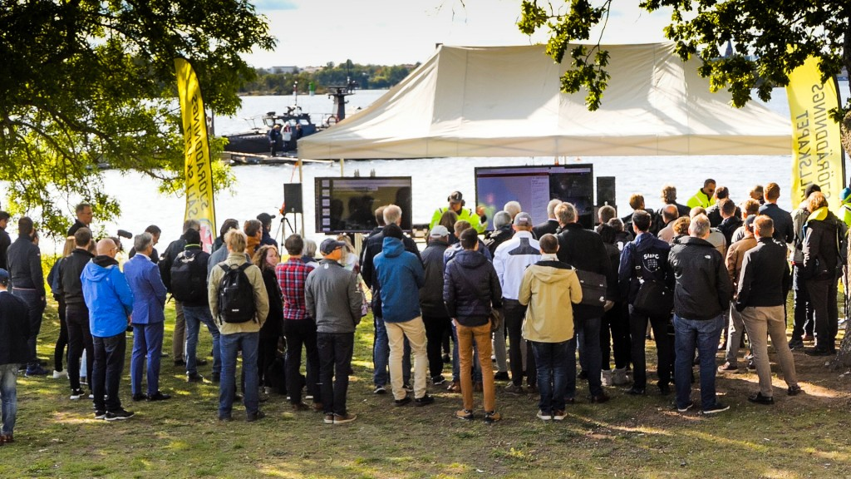
WARA-PS: Workshops at Gränsö Slott
Workshops and demos at the fancy hotel Gränsö ”palace”
Advice: Take opportunity to talk to the WARA participants, lots of accumulated real-world experience and potential collaboration opportunities

Slide 8
What Can WARA Do For Us?
Test your theory in the real-world and collect data for papers
You can learn a lot talking to the partners
Identify new research problems/data
Learn practical skills attractive to applied R&D
Good showcase for your research career
Advice: Demonstrating is hard work but fun – push your limits
Can participate just to collect e.g. sensor data
Partner with somebody with application experience
Mind the theory-application gap, but it is also an opportunity

Slide 9
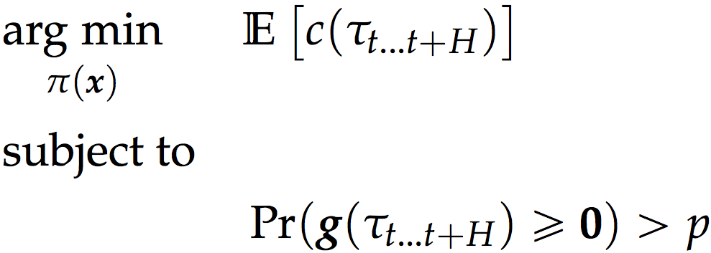
My Research Focus Learning Decision-Making Under Uncertainty for Autonomous Robots
Learn safe decision-making for real-world robots
Using techniques both from machine learning and optimization-based control
Notes:
The focus is on learning (and recognizing?) behavior for autonomous robots. Much of it can be categorized into applied reinforcement learning, and we work with techniques based on optimization, bayesian approaches, and recently deep learning. As our ambition is autonomous robots, we give particular attention to the safety requirements and resource constraints of real robots.

Slide 10
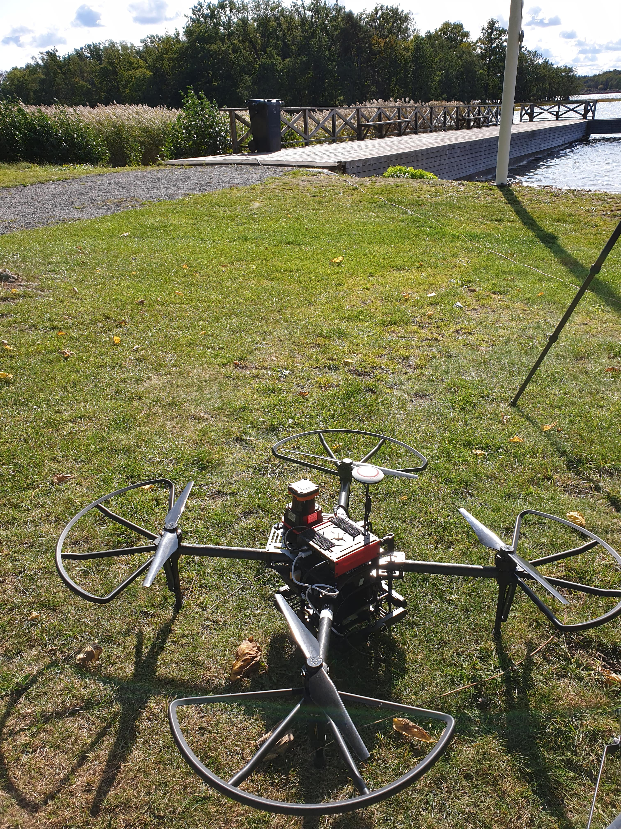
My Research Focus Learning Decision-Making Under Uncertainty for Autonomous Robots
Learn safe decision-making for real-world robots
Using techniques both from mahine learning and optimization-based control
Computational limitations
Notes:
The focus is on learning (and recognizing?) behavior for autonomous robots. Much of it can be categorized into applied reinforcement learning, and we work with techniques based on optimization, bayesian approaches, and recently deep learning. As our ambition is autonomous robots, we give particular attention to the safety requirements and resource constraints of real robots.

Slide 11
My Research Focus Learning Decision-Making Under Uncertainty for Autonomous Robots
Learn safe decision-making for real-world robots
Using techniques both from machine learning and optimization-based control
Computational limitations and safety constraints of real robot platforms
Notes:
The focus is on learning (and recognizing?) behavior for autonomous robots. Much of it can be categorized into applied reinforcement learning, and we work with techniques based on optimization, bayesian approaches, and recently deep learning. As our ambition is autonomous robots, we give particular attention to the safety requirements and resource constraints of real robots.

Slide 12
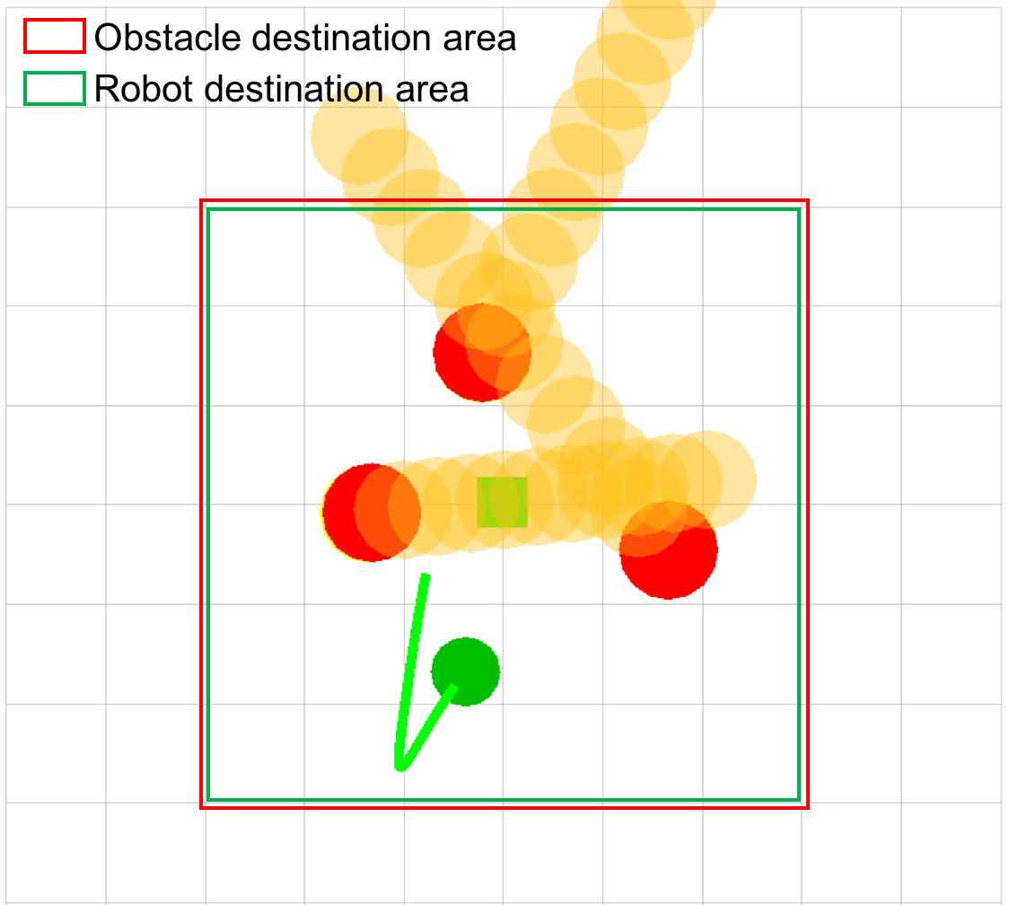
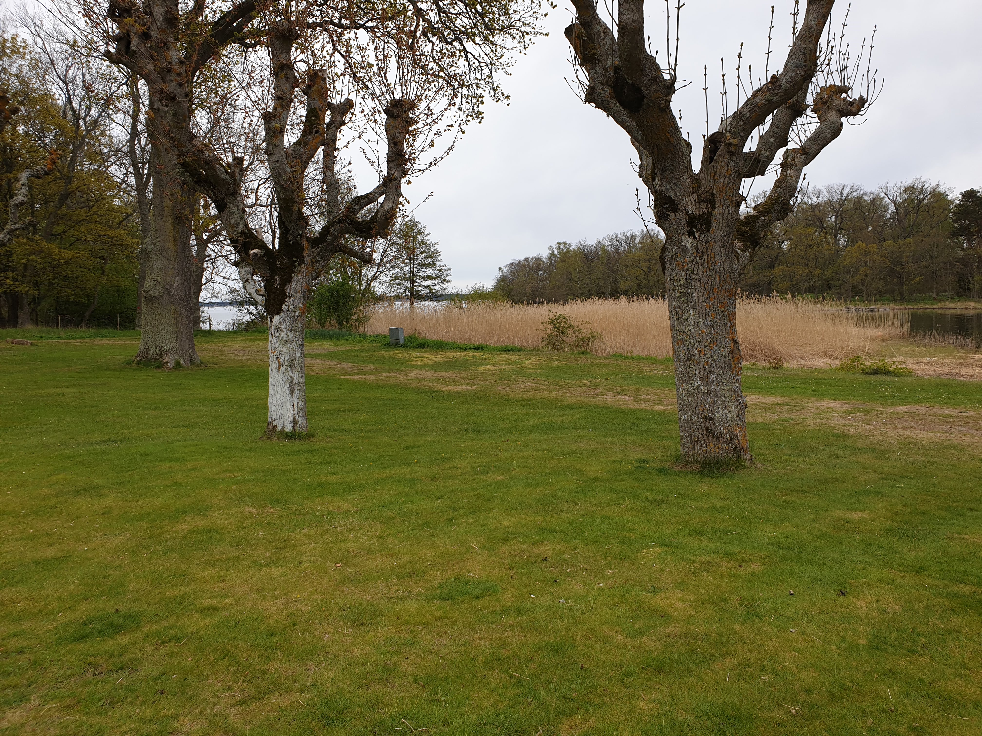
Demo: Obstacle Avoidance under Uncertainty
Problem: Uncertainty from inexact quadcopter motion, obstacle sensing, and obstacle motion (people)
Method: Learning risk-adjustment for deterministic MPC such that safety constraints hold under uncertainty.
Basically: MPC + constrained policy search
Showcased with the MPC and Gaussian process safety optimization running live in real-time
Obstacles: Trees, me.

Slide 13
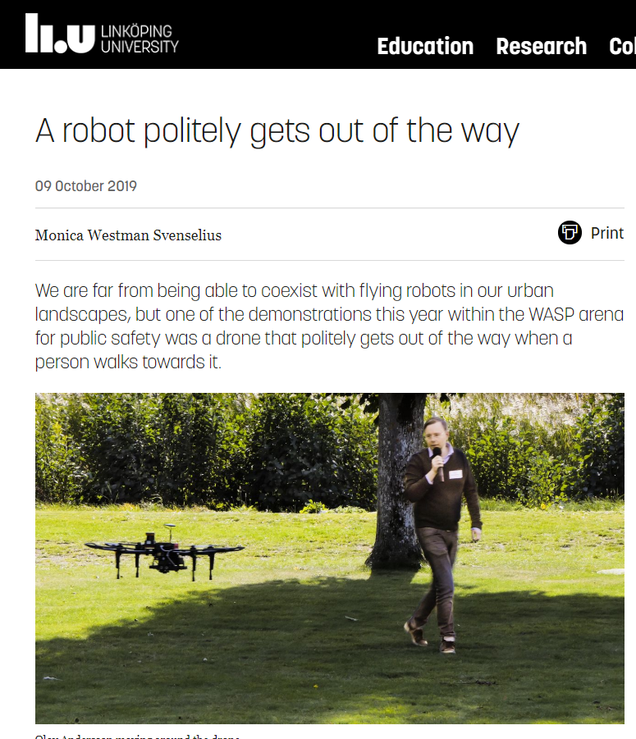
Result: Good PR in Reporting From the Event

Slide 14
What Can WARA Do For Us?
Test your theory in the real-world and collect data for papers
You can learn a lot talking to the partners
Identify new research problems/data
Learn practical skills attractive to applied R&D
Good showcase for your research career
Advice: Demonstrating is hard work but fun – push your limits
Can participate just to collect e.g. sensor data
Partner with somebody with application experience
Mind the theory-application gap, but it is also an opportunity

Slide 15
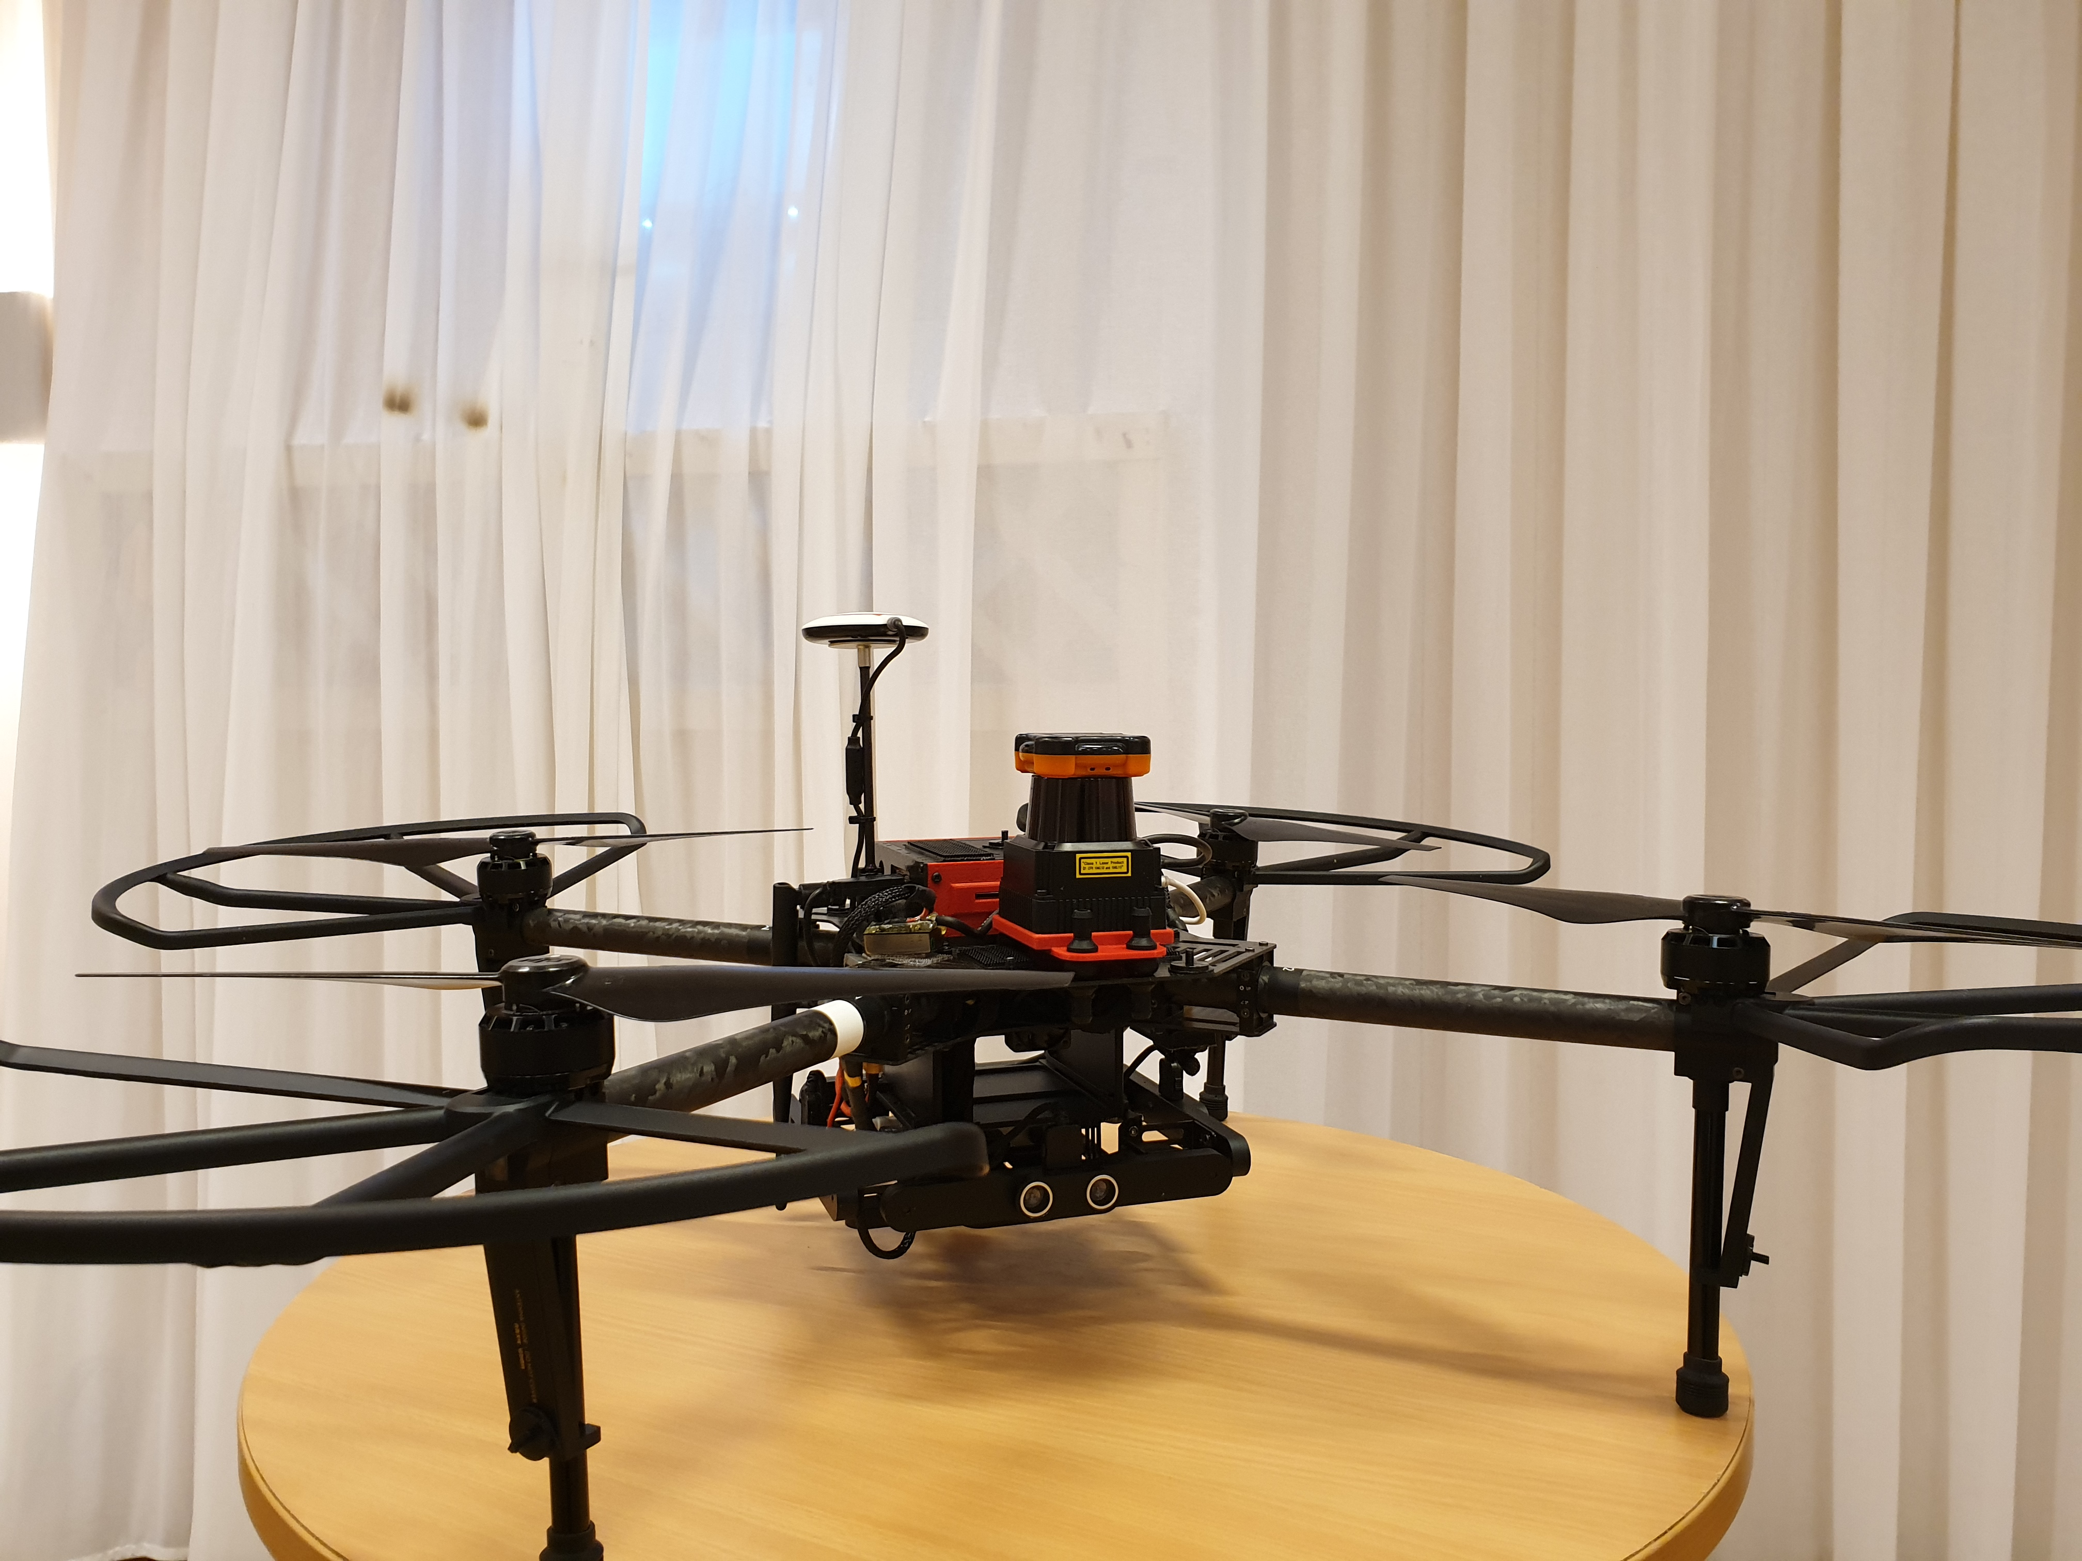
Thank You For Listening!

