Slide 1
Introduction to WASP and WASP Graduate School
Karl-Erik Årzén, Lund University, Chair PMG Fredrik Heintz, Linköping University, Chair GSM

Slide 2
Kickoff Program
13:00 – 13:25 Welcome and introduction to WASP and WASP Graduate School – Karl-Erik Årzén and Fredrik Heintz
13:25 – 14:00 WASP graduate school program – Bo Bernhardsson and Patric Jensfelt
14:00 – 14:10 Singapore Study Visit – Caroline Svahn, Joakim Johnander
14:10 – 14:20 Experiences from WARA – Olov Andersson
14:20 – 14:30 Experiences from international exchange – Mia Kokic, Natalie Pintar
14:30 – 14:40 WASP Program Office - Elina Hjertström, Petronella Norberg, Anna Björnemo, Natalie Pintar, Jessica Danielsson Piazze
14:40 – 14:45 WASP Student Council - Christoffer Blöcker, Martin Andersson, Alexandre Martins
14:45 – 15:15 Coffee
….

Slide 3
Kickoff Program
15:15 – 16:00 Pitch presentations by all new students
AS – Room: Operan
AI – Room: Solot
16:00 – 17:00 Discussion in smaller groups
AI – Room: Solot
AS@Lund – Room: Opera
AS@KTH 1 – Room: Sonaten
AS@KTH 2 – Room: Operetten
AS@LIU/Chalmers/UmU – Room: Pressläktaren
19:00 - ... Kick-off Dinner, Scandic Frimurarehotellet (”Frimis”), Sankt Larsgatan 14
Mingle in the lobby from 18:00

Slide 4
Kickoff Program
Tuesday 14 Jan
9:00 – 10:00 AS PhD students – Introduction to Autonomous Systems 1 (Crusellhallen) – Bo Bernhardsson and Patric Jensfelt
-----------------------------------------------------------------------------------
9:00 – 10:00 AI PhD students – Introduction to mandatory courses for the AI track (Solot) – Warwick Tucker
10:00 – 10:30 Coffee
10:30 Winter School starts (Crusellhallen)

Slide 5
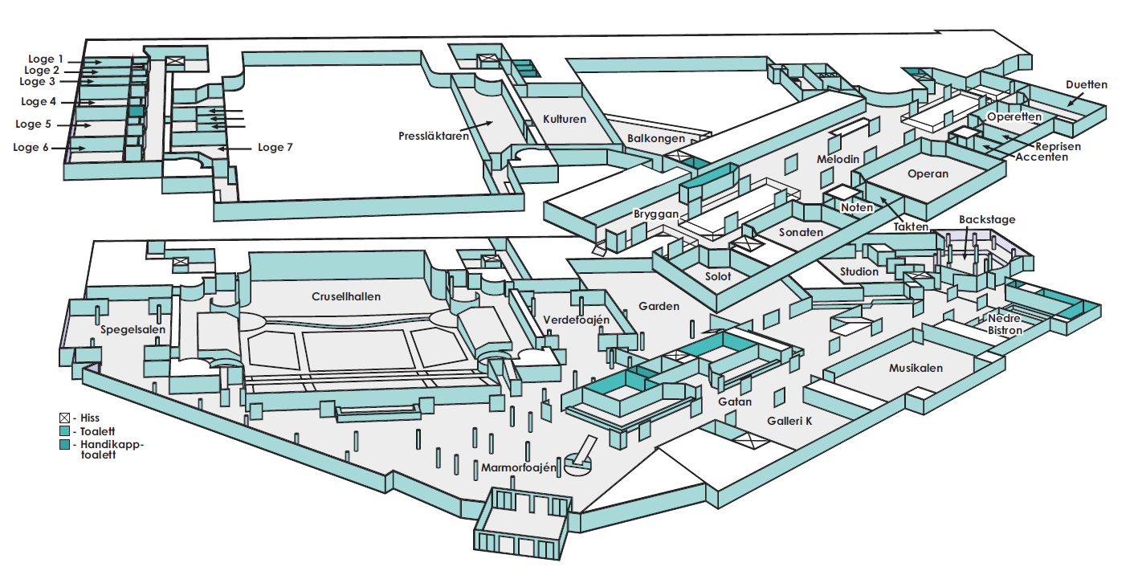

Slide 6
The WASP Story

Slide 7
Swedish Research Funding
But still in 2014, the amount of research funding in Sweden for AI and autonomous systems was very low
Swedish Research Council (”VR”)
VINNOVA
Swedish Foundation for Strategic Research (”SSF”)
...

Slide 8
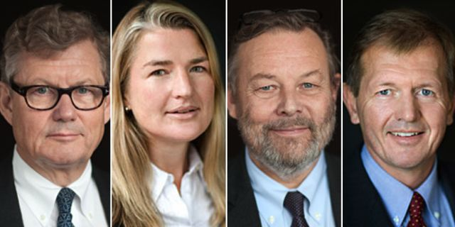
Knut and Alice Wallenberg Foundation (KAW)
WASP
Sweden’s largest research program ever
5.5 BSEK
2015 – 2029
”for the benefit of Swedish industry”

Slide 9
WASP Outcomes
WASP will produce research results, demos, publications, products, ......,
but the main outcome of WASP is you!
Competence buildup in Swedish industry and academia through human knowledge transfer
PhD students, postdocs, and faculty recruitments
Aim: 400 PhD students (excl affiliated), Now: 233 (Oct 2019)
Aim: 60 new faculty, Now: 27

Slide 10
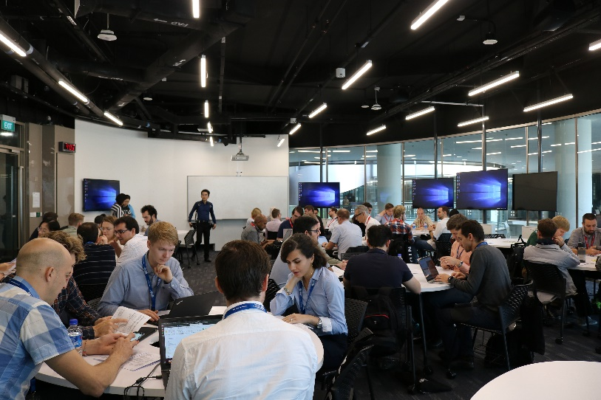
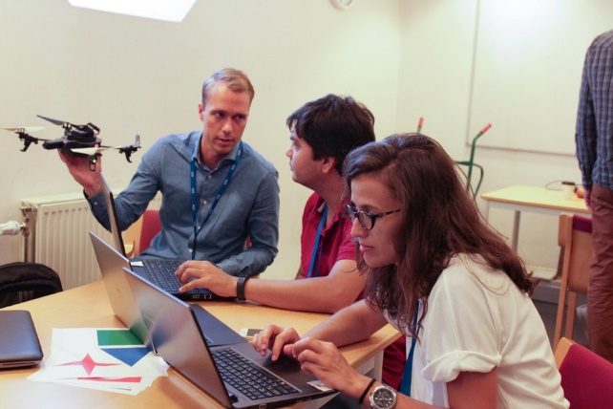
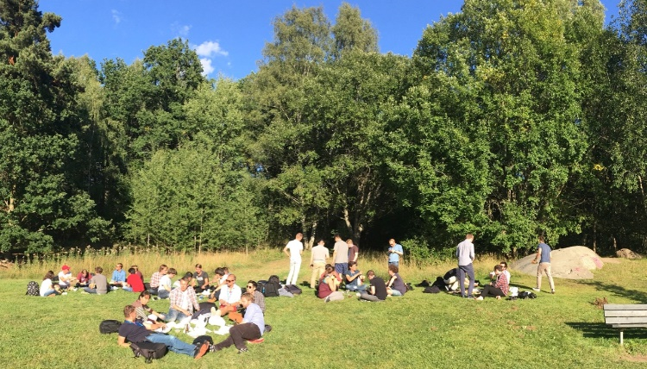
What’s in it for you?
Interesting PhD courses
Summer Schools
WASP network
International outlook
Study trips
Exchanges
International postdocs
Industrial connections
WARA demonstration arenas
and eventually a PhD

Slide 11
WASP Vision
Excellent research and competence in artificial intelligence, autonomous systems and software for the benefit of Swedish industry.

Slide 12
WASP Mission
Build a world-leading platform for academic research that interacts with leading companies in Sweden to develop knowledge and competence for the future

Slide 13
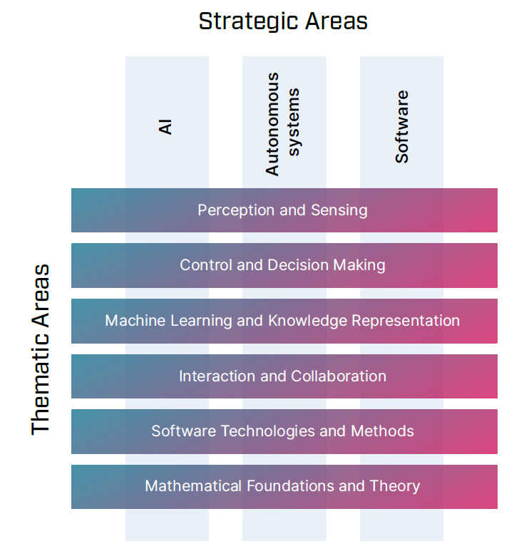
Research Matrix

Slide 14
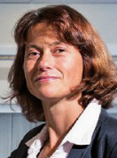
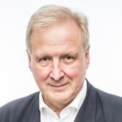
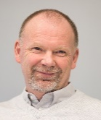
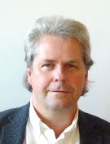
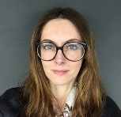
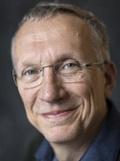
Research Organization
WASP Board
Chair: Sara Mazur, KAW
WASP
Director: Lars Nielsen/ Anders Ynnerman, LiU
WASP-AS
Chair: Karl-Erik Årzén, LU
WASP-AI
WASP-AI/MLX
Chair: Danica Kragic, KTH
WASP-AI/MATH
Chair: Johan Håstad, KTH

Slide 15
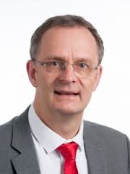
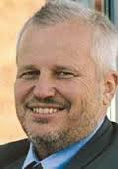
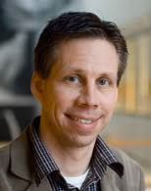
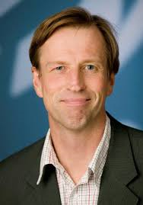
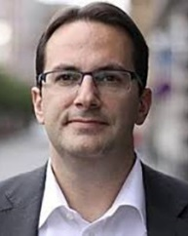
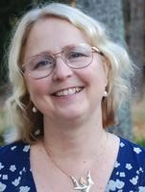
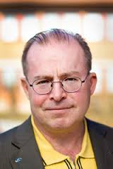
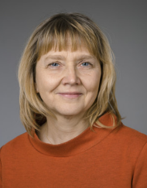
WASP Board 2019
Alf Isaksson ABB AB, Global Research Manager Control
Anders Palmqvist Chalmers, Vice President
Viktor Öwall LTH , Dean
Sara Sjöstedt de Luna
UmU, Pro dean
Mille Millnert Linköping University Chair WASP
Pontus de Laval Saab AB, CTO
Annika Stensson-Trigell KTH, Vice President
Sara Mazur KAW
Vice Chair WASP
Nicolas Moch SEB AB, CIO
Ulf Nilsson Linköping University, Dean

Slide 16
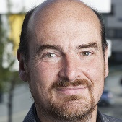
WASP Graduate School
One Graduate School with two tracks
Autonomous Systems and Software (AS)
Artificial Intelligence (AI)
For each track, a mandatory course package
All courses are open to all WASP PhD students
More information in WASP Highlights
Graduate School Management group (GSM)
Director: Fredrik Heintz
GS-AS
Director: Karl-Erik Årzén
GS-AI
Director: Warwick Tucker

Slide 17
Batches
WASP-AS and WASP-AI have calls for new PhD students every other year
WASP-AS – 2015, 2017, 2019, ....
WASP-AI – 2018, 2020, ....
The students from the annual calls are called Batches
So far we have
WASP-AS Batch 1
WASP-AS Batch 2
WASP-AS Batch 3 (most of you)
WASP-AI Batch 1
Fall 2019 it was decided to open an extra call for affiliated WASP-AI PhD students
WASP-AI Batch 1.5? (some of you)
PhD students that are hired directly by a WASP recruitment are considered to belong to the closest relevant batch (maybe some of you)

Slide 18
WASP Acronyms
WASP contains many acronyms that are good to know
PMG – Program management group
PMG responsible for WASP-AS
The members are the official university representatives: Karl-Erik Årzén (Lund), Anders Ynnerman (Linköping), Bo Wahlberg (KTH), Ivica Crnkovic (Chalmers), Erik Elmroth (Umeå)
PM-AI/MLX
PM-AI/MATH
GSM – Graduate School Management Team
GS-AS - responsible for AS track
GS-AI - responsible for AI track
IMAG - International Management and Affiliations Group
Handles relations with collaborating universities
Exchange periods, international postdocs, .....
ISAB – International Scientific Advisory Board
Scientific advisors to WASP

Slide 19
Clusters
A mechanism for creating smaller, more research-focused networks than what is provided by the batches
Currently WASP has 12 clusters, see
http://wasp-sweden.org/research/wasp-clusters
You have received an email with a link to a cluster selection form in December 2019
You may belong to two clusters if you want – one major and one minor
Cluster meetings after lunch on Wednesday

Slide 20
WASP-HS
WASP-Humanities and Society, a separate program of SEK 660 million with its own board and organization
The Marianne and Marcus Wallenberg Foundation (a “sister” foundation to KAW)
Initial areas of interest:
Ethics for autonomous systems and AI
Economy of autonomous systems and AI
Law for autonomous systems and AI
Social consequences, including effects on the labor market of autonomous systems and AI
Improved information systems for autonomous systems and AI

Slide 21
WASP Graduate School
Fredrik Heintz Graduate School Director

Slide 22
WASP Graduate School
One Graduate School with two tracks
Autonomous Systems and Software (AS)
Artificial Intelligence (AI)
For each track, a mandatory course package
All courses are open to all WASP PhD students
More information in WASP Highlights
Graduate School Management group (GSM)
Director: Fredrik Heintz
GS-AS
Director: Karl-Erik Årzén
GS-AI
Director: Warwick Tucker

Slide 23
The Graduate School Mission
The mission of the WASP Graduate School is to educate PhDs with skills in strategically important disciplines within WASP, together with a broad knowledge of AI, autonomous systems and software development.

Slide 24
Goals – Students
You should become knowledgeable researchers in the area of AI, autonomous system or software.
You should form a strong sense of belonging to WASP connecting you together. You are WASP!
You should get to know Swedish industry.
You should form a strong and valuable international academic-industrial network.
You should strive for greatness.

Slide 25
Goals – GSM
We will organize courses and activities that respect the needs of a heterogeneous group of students spread out over Sweden
We will organize activities to provide academic and industrial researchers and engineers with state-of-the-art knowledge in AI, autonomous systems and software.
We will provide added value to your PhD education.
We will provide opportunities to those that really want to become great!

Slide 26
Activities
Winter Conference
Yearly conference for all WASP PhD students to present their research and get friendly feedback
Courses
Roughly one mandatory 6hp course per semester
All WASP courses available
Summer Schools
Usually in August
International Trip
Usually in October

Slide 27
Take the opportunity that WASP is and strive to become great!

